Slide 1


Slide 2

JUnit 5 Basics

Slide 3
Agenda:
What’s Unit testing?
Understand JUnit 5 Architecture
Test Life Cycle
Annotations
Conditional execution
Assumptions
Assertions

Slide 4



What’s Unit Testing
UNIT TESTING is a level of software testing where individual units/ components of a software are tested.
JUnit is the most popular unit Testing framework in Java. It is explicitly recommended for Unit Testing.
.

Slide 5
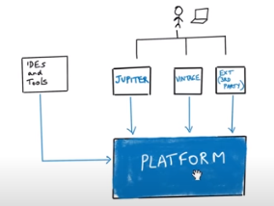
JUnit 5Architecture
.

Slide 6
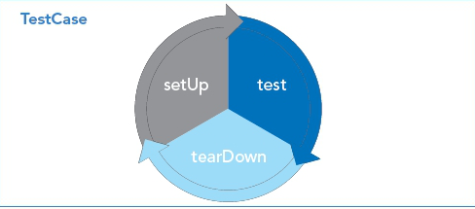
Test Life Cycle of JUnit 5
A JUnit test case can contain many test methods. Each method identified as a test will be executed within the JUnit test lifecycle. The lifecycle consists of three pieces: setup, test and teardown, all executed in sequence.
In JUnit 5 two more phases of cycle is added as below :
@BeforeAll – Should be called once in entire test execution cycle.
@BeforeEach – Invoked each instance of Test.
@Test – Denotes test method
@AfterEach –Should be called after each Test Method
@AfterAll – should be exceuted once entire test exceution cycle
.

Slide 7
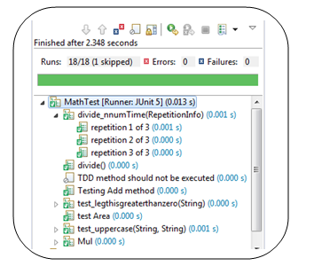
Annotations
JUNIT ANNOTATIONS is a special form of syntactic meta-data that can be added to Java source code for better code readability and structure.
Below are the annotations used in JUnit 5 :
@DisplayName
@ParameterizedTest
@RepeatedTest
@Disabled
@Timeout
@TestInstance
@Nested
@Tag
.

Slide 8
Conditional Execution
Conditional Execution is Enable the test based on particular condition. JUnit 5 Jupiter API provides a various conditions to enable or disable the test based on certain conditions.
Below are the Conditional executions of Enable or Disable a test :
@EnabledOnOS(OS.WINDOWS)
@DisableOnOS(OS.LINUX)
@EnabledOnJre(JRE.JAVA -11)
@EnabledIfsystemProperty(name=“OS.name”, matches=“Windows 7”)
@EnabledIfEnvironmentVariable
.

Slide 9
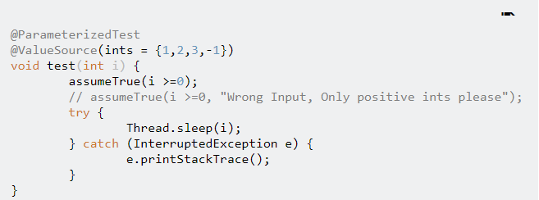
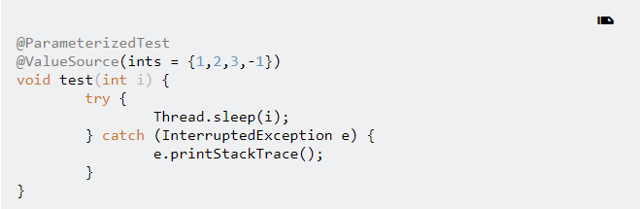
Assumptions
Assumptions are static methods to support conditional executions based on assumptions.
Helps us in skipping a test for some specific scenario.
Assumptions in Junit 5:
assumeFalse()
assumingThat​()
assumeTrue()
.

Slide 10
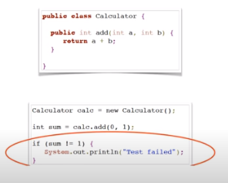
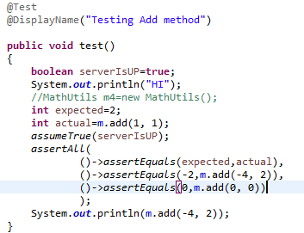
Assertions
Assertions - are utility methods to support asserting conditions in tests.
assert All –is the new assertion introduced in JUnit 5 .This assertion allows the creation of grouped assertions.
Assertion Methods:
assertTrue()
assertEqual()
assertNotEquals()
assertThrows()
.

Slide 11
Demo

Slide 12
T H A N K Y O U !

